Slide 1

Machine Learning to Capture Distribution from Data
Chandra Prakash Meena BTech Computational Engineering
Guided By: Prof. Kishalay Mitra

Slide 2
Outline Of Presentation
Introduction
Objective
Challenges
Proposed Solution
Variational Autoencoders (VAEs)
VAE Architecture
Objective Functions of VAE with Reparameterization Trick
Training Process
Result and Conclusion

Slide 3
Introduction
Objective
Develop a machine learning model capable of learning and reconstructing the distribution of high-dimensional data with minimal loss.
Key Challenges:
High-dimensional data often contains redundant features.
Efficiently compressing data while retaining essential patterns.
Reconstructing data with high fidelity for applications like anomaly detection, data generation, and denoising.
Proposed Solution:
Use a Variational Autoencoder (VAE) to:
Encode high-dimensional data into a compact latent space representation.
Reconstruct data while learning its underlying distribution through probabilistic modeling.

Slide 4
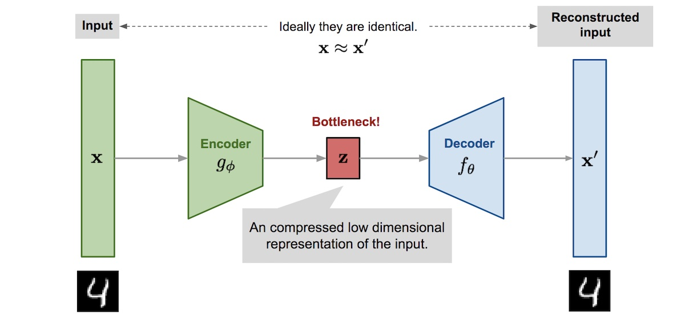
Autoencoders
An unsupervised neural network model designed for feature extraction, data compression, and denoising.
Consists of an encoder that reduces dimensionality and a decoder that reconstructs data
Encoder:
Input Layer: Takes raw data.
Hidden Layers: Progressively reduce dimensions, capturing essential features.
Bottleneck Layer (Latent Space): Represents compressed data.
Decoder:
Expands encoded data back to original dimensions.
Hidden Layers: Increase dimensions progressively.
Output Layer: Produces reconstructed data, close to input.

Slide 5
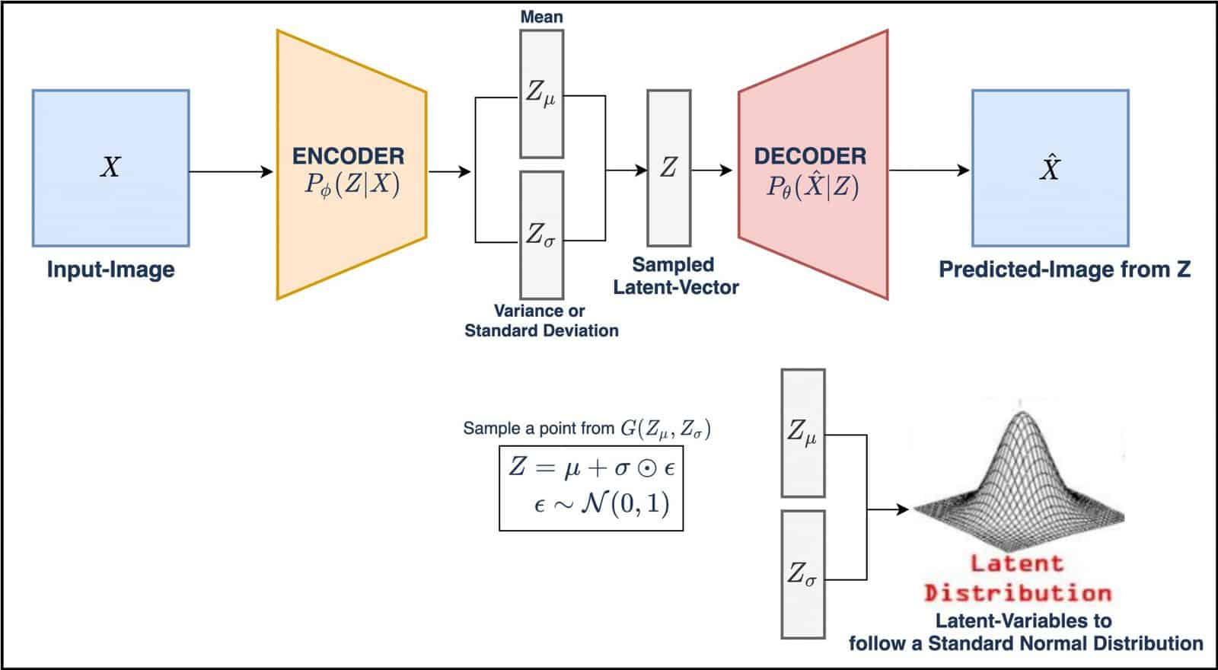


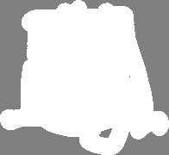
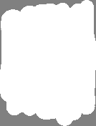
Variational Autoencoder
In a Variational Autoencoder (VAE), the encoder doesn’t just output a single, fixed latent vector as in traditional autoencoders; instead, it outputs a probability distribution for each attribute in the latent space.

Slide 6

Objective Functions of VAE
Reconstruction Loss: This loss ensures that the images generated by the decoder closely resemble the input images.
KL Divergence: This measures the difference between the encoder’s distribution and a standard normal distribution. It is a regularizer, ensuring the latent variables are close to a standard normal distribution.
Combined Loss for VAE

Slide 7
Reparameterization Trick
In standard VAEs, the encoder outputs mean (μ) and variance (σ^2) to represent a probability distribution in the latent space, and sampling Z directly makes the operation non-differentiable, making backpropagation challenging.
Z = N(μ(x),σ^2(x))
The Reparameterization Trick rewrites the sampling process to make it differentiable by using a fixed distribution (standard normal) for the random noise ϵ.
z=μ(x)+σ(x)⋅ϵ, ϵ∼N(0,1)
μ(x) = Mean output from encoder
σ(x) = Standard Deviation
ϵ: Noise drawn from a standard normal distribution ϵ∼(N(0,1))
Using this we can compute gradient of the loss (Reconstruction + KL divergence) with respect to μ(x)and σ(x) using backpropagation.

Slide 8
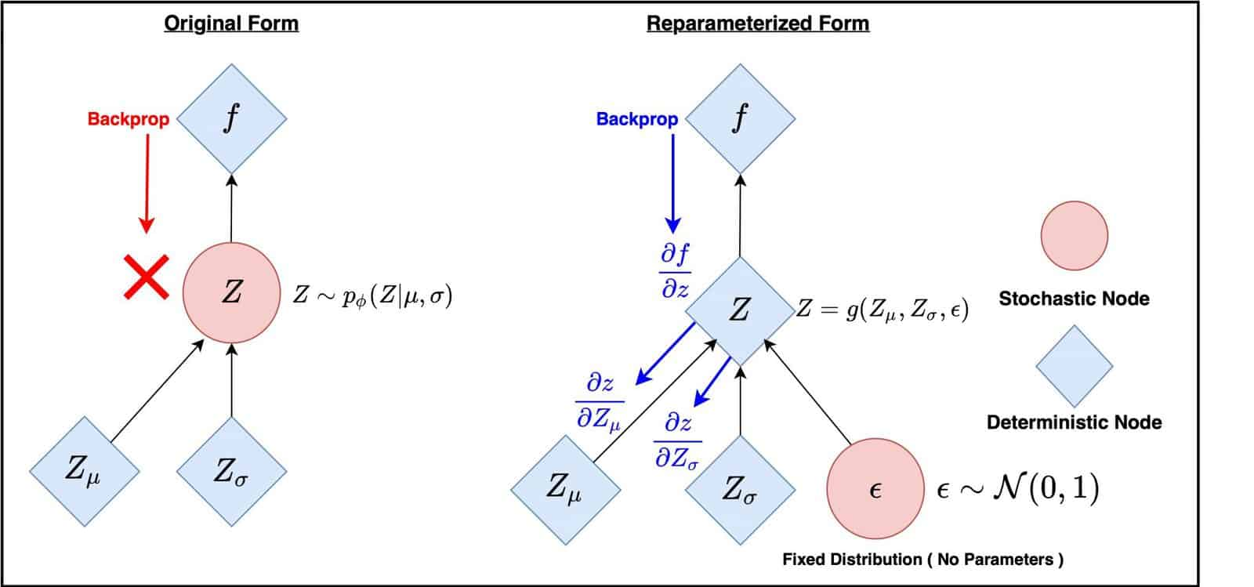



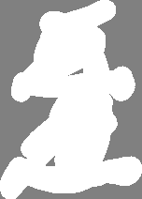

Diagrammatic form of Reparameterization Trick

Slide 9
Training Process of VAE
Input Data:
We generated random uniformly distributed raw data that is passed into the Encoder for dimensionality reduction.
Encoder:
Learns two key representations:
Mean (μ) and Standard Deviation (σ).
Encodes input data as a latent probability distribution.
Decoder:
Reconstructs data from sampled latent representation.
Maps latent dimensions back to the original data dimensions.
Objective Function:
Reconstruction Loss: Ensures accurate data reconstruction.
KL Divergence: Regularizes latent space to align with a standard normal distribution.

Slide 10
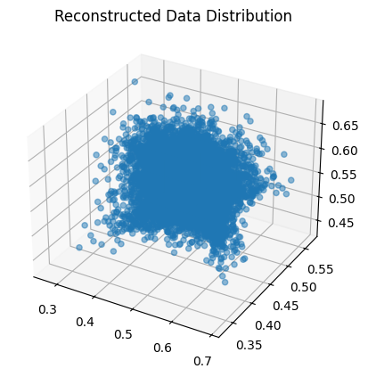
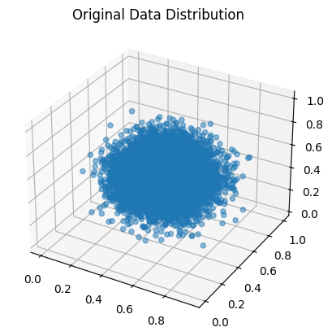
Result and Conclusion
Original vs. Reconstructed Distribution
The original data distribution shows a uniform spread in the feature space.
The reconstructed data distribution demonstrates a close resemblance to the original distribution, suggesting that the autoencoder is effectively capturing the main structure but introducing some minor reconstruction errors.

Slide 11
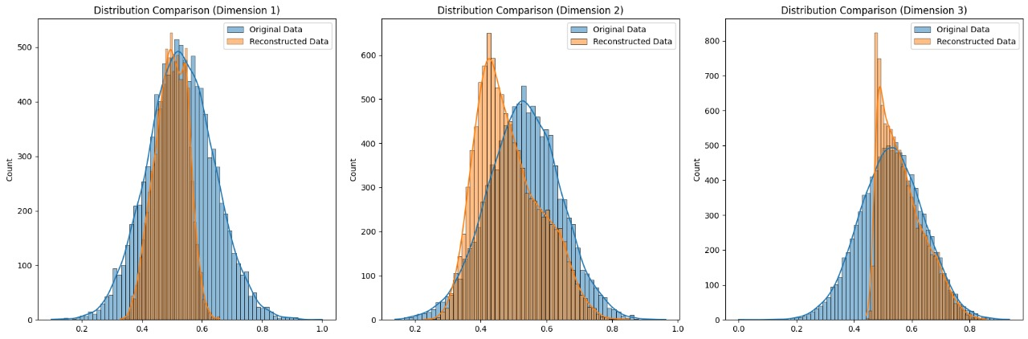
Result and Conclusion
Overall Performance:
The autoencoder preserves the core structure of the original data distribution.
Reconstruction errors arise due to model limitations, over-simplification, or the influence of noise.

Slide 12
THANK YOU

